Slide 1
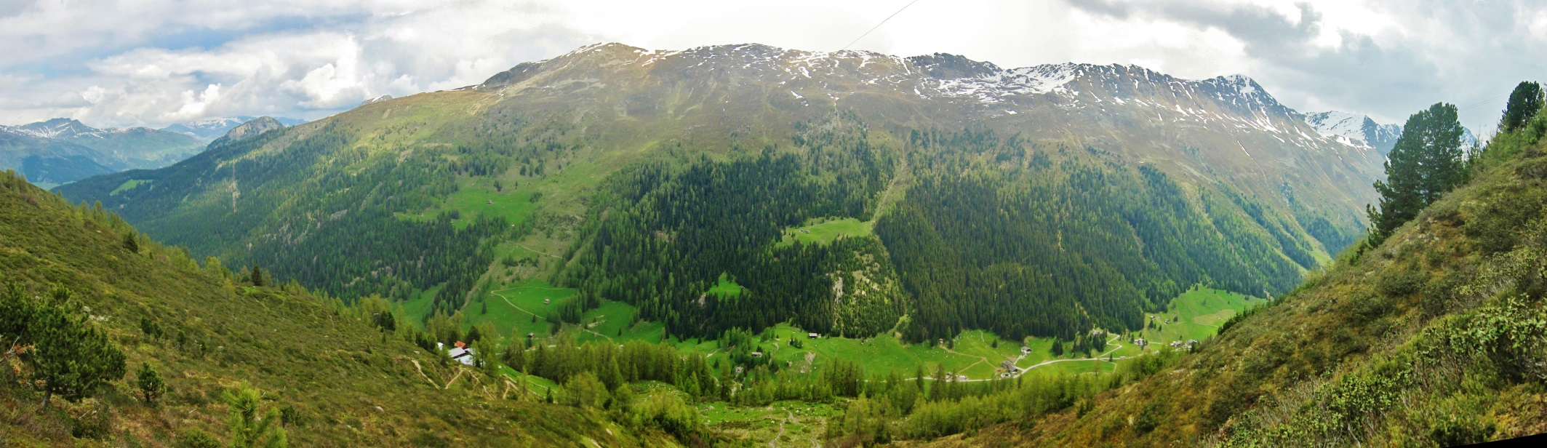


G‐TREE Experiment Stillberg Davos, Switzerland
started in May/June 2013
Esther Frei, Giulietta Bernareggi, Eva Bianchi, Melissa Dawes, Peter Bebi, Christian Rixen

Slide 2
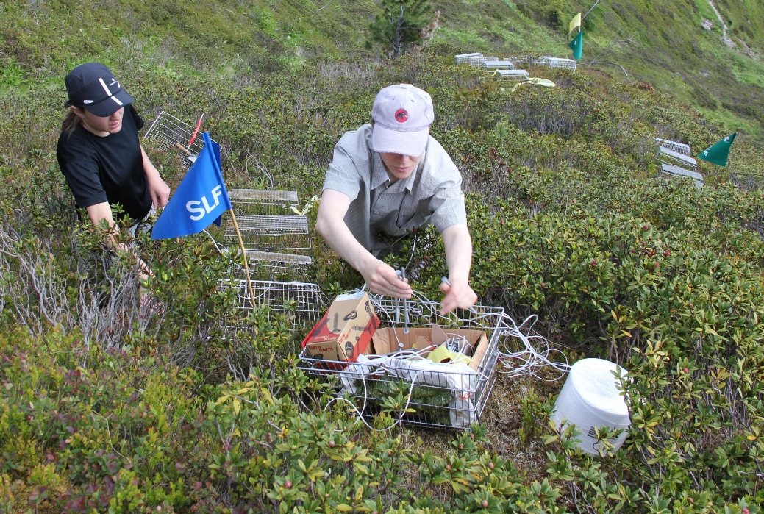
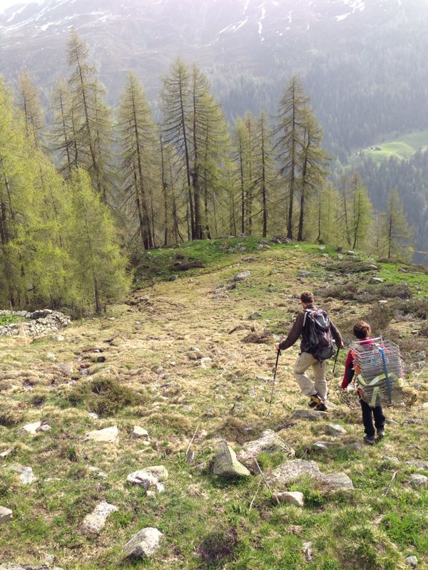
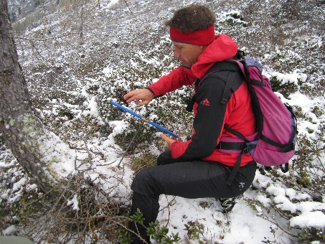
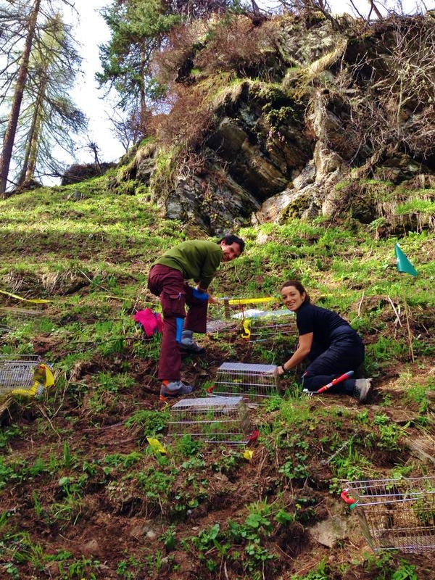
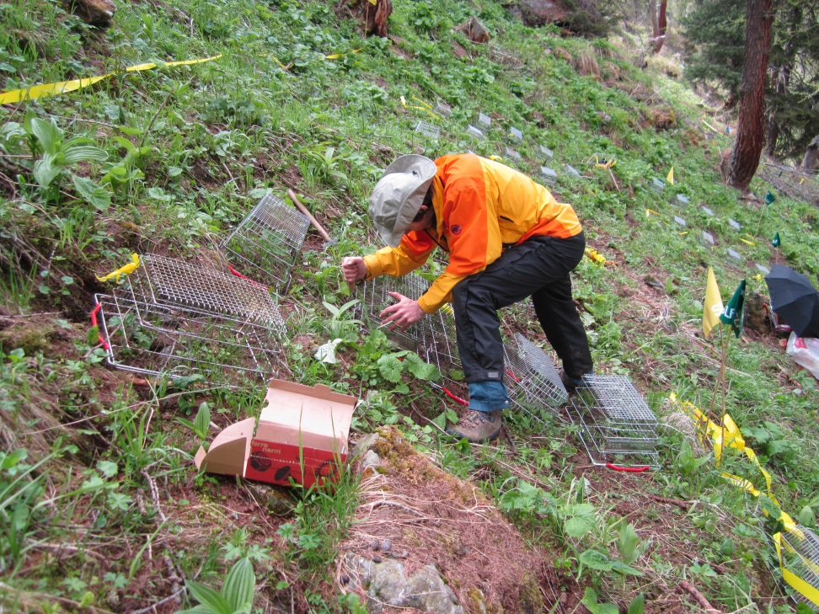
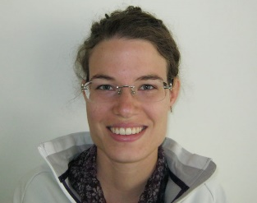
Swiss G-TREEers
Christian
Peter
Melissa
Esther
Eva
Alessio
Giulietta
Martin

Slide 3
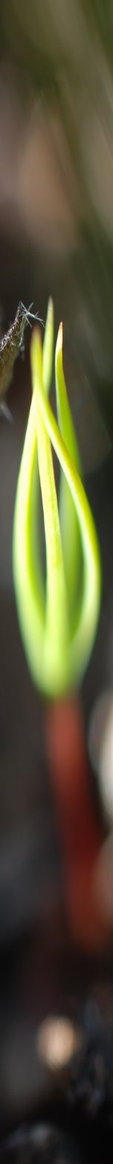
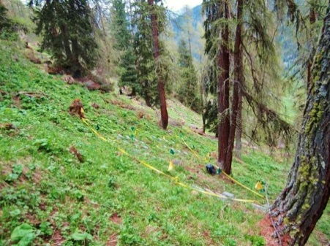
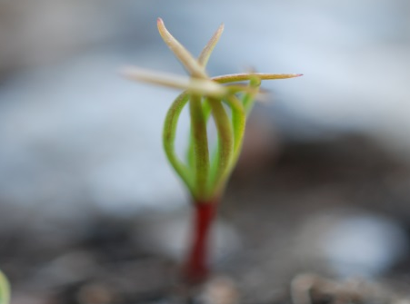
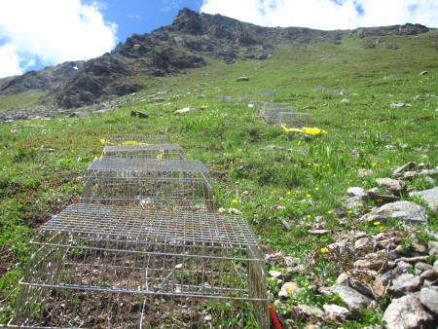
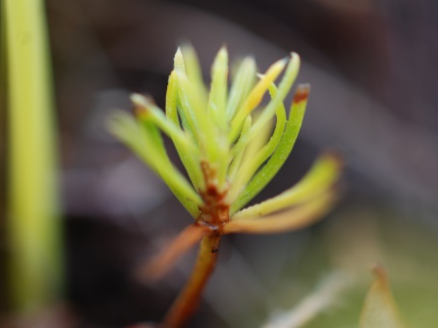
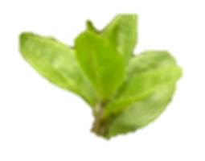
G-TREE experiment Stillberg
3 levels of participation
3 elevations: F (forest), T (treeline), A (alpine tundra)
2 species: European larch (Larix decidua), Norway spruce (Picea abies)
2 provenances: low and high elevation
3 treatments: seeding (2 levels), scarification (2 levels), herbivore exclosure (2 levels)
2 years of seeding: 2013 and 2014
Notes:
Set up 3 site
Used 2 sp belonging to
Performed 3 treat

Slide 4
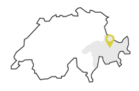
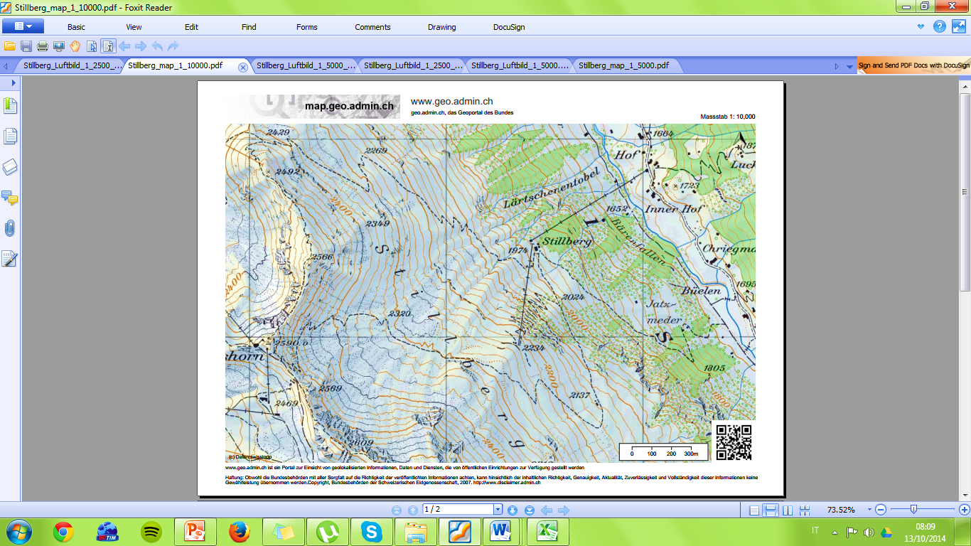
Study Area
Davos
Forest Site 1930 m a.s.l.
Treeline Site 2100 m a.s.l.
climate station
Alpine Site 2390 m a.s.l.

Slide 5
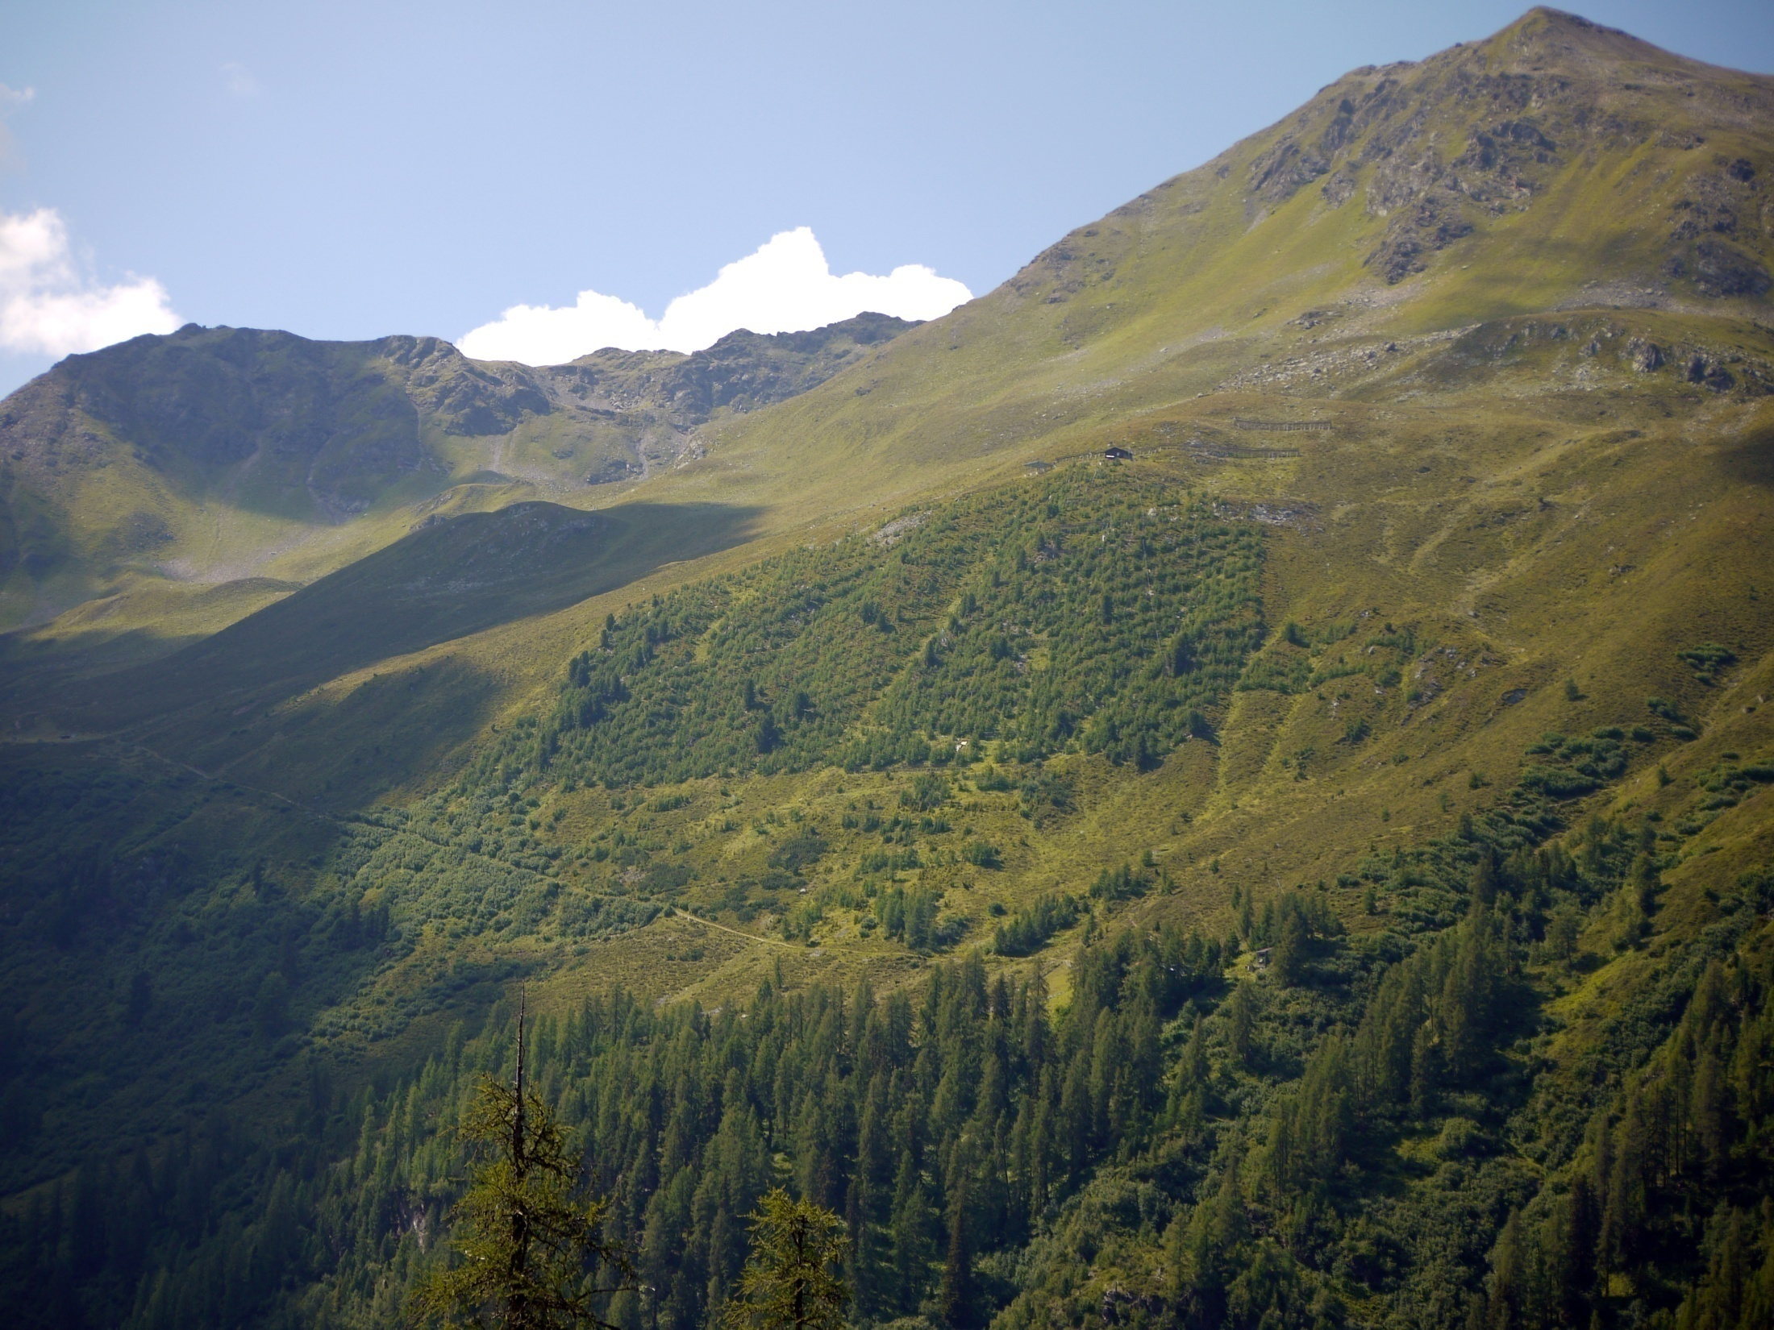
Stillberg Afforestation Davos, Switzerland
Alpine Site 2390 m a.s.l.
Treeline Site 2100 m a.s.l.
climate station
Forest Site 1930 m a.s.l.
Long-term afforestation research area:
92,000 trees of 3 treeline species planted in 1975
Notes:
NE-exposed 25 to 30° slope

Slide 6
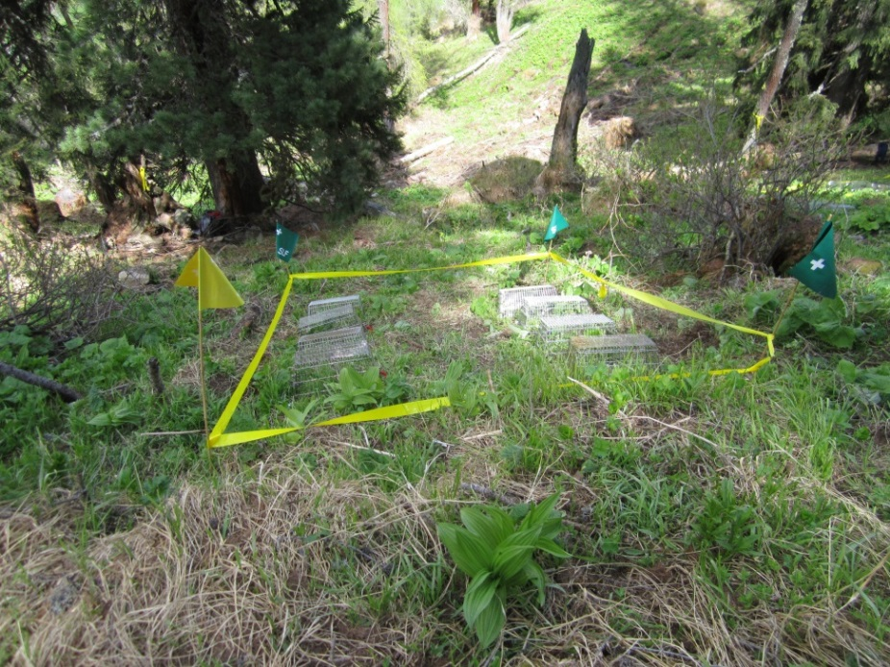
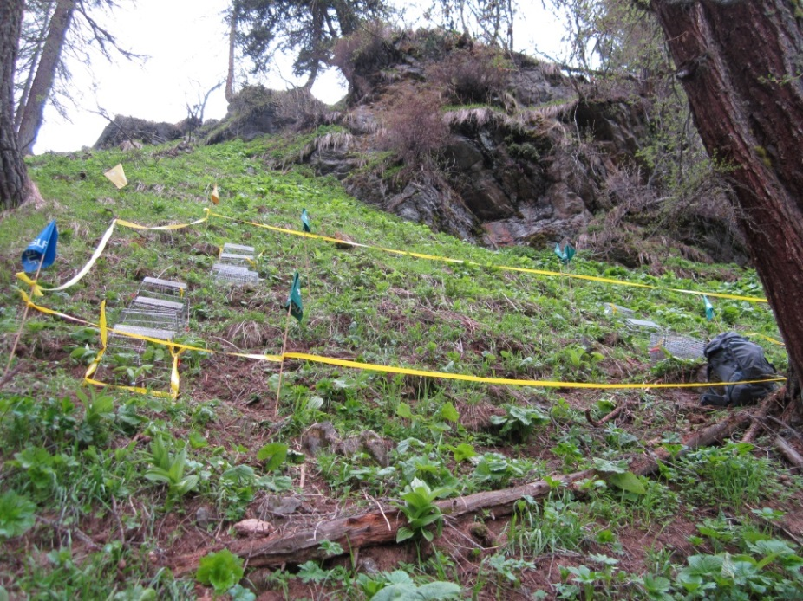
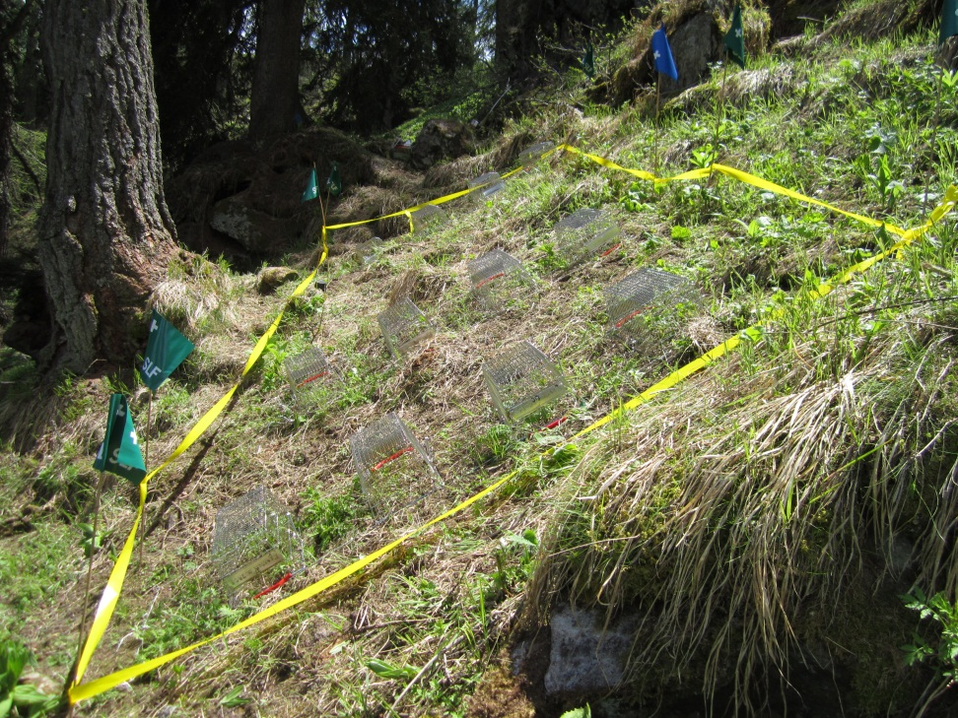
Site F – 1950 m a.s.l.
Notes:
Adenostylion:tall forb meadows

Slide 7
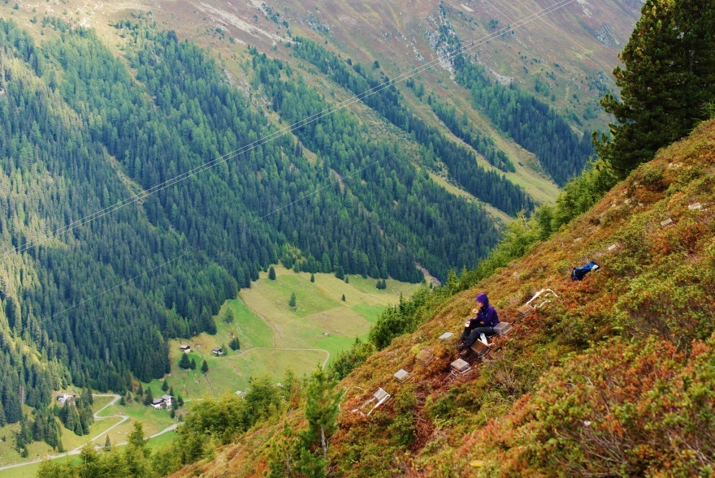
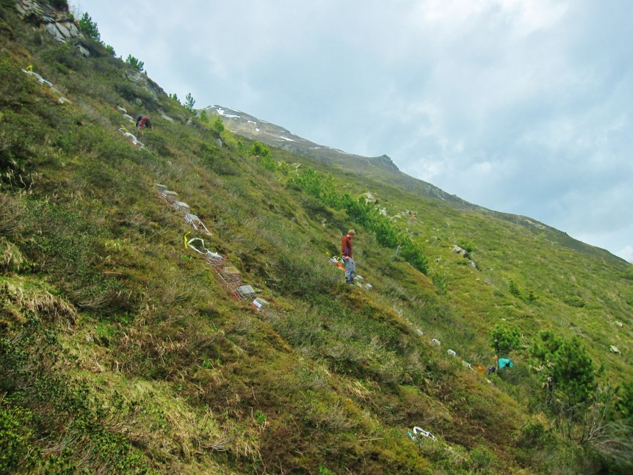
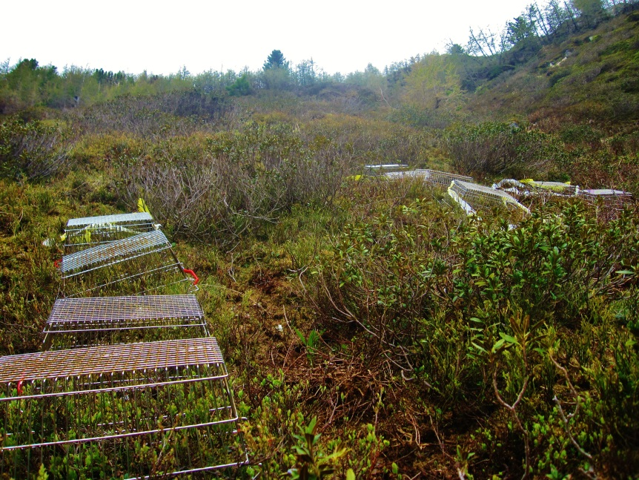
Site T – 2100 m a.s.l.

Slide 8
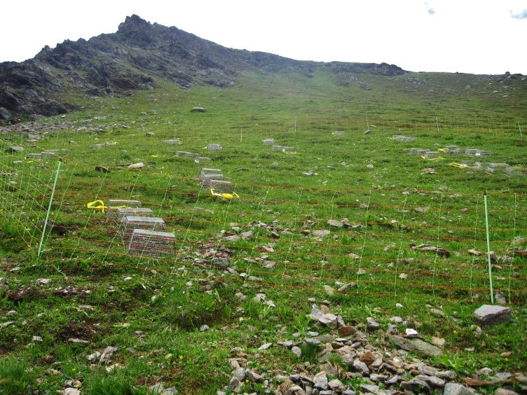
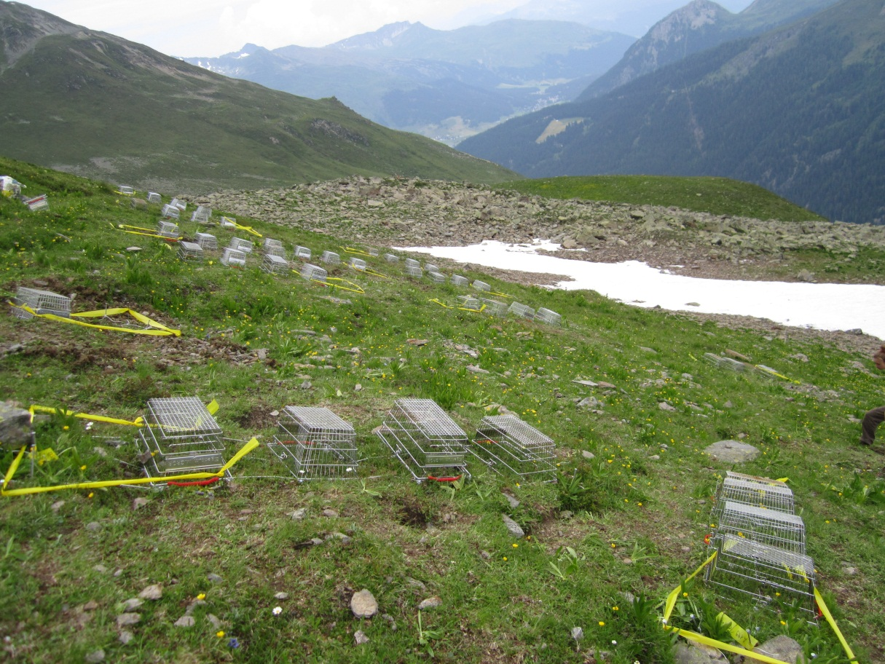
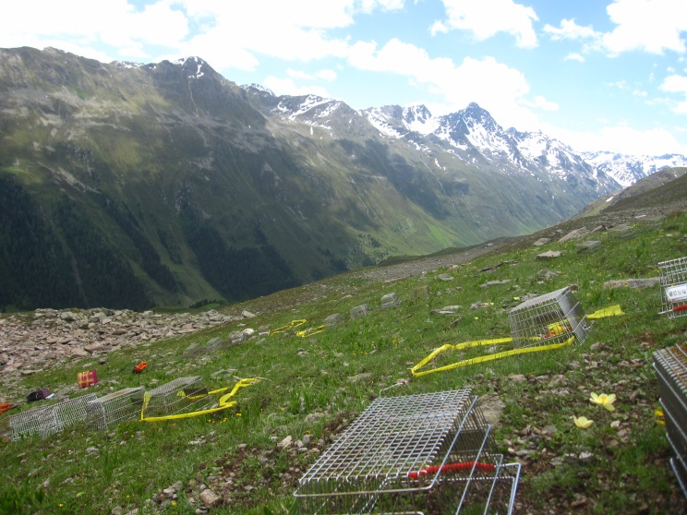
Site A – 2300 m a.s.l.
Notes:
Alpine tundra

Slide 9

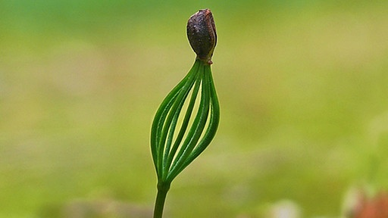
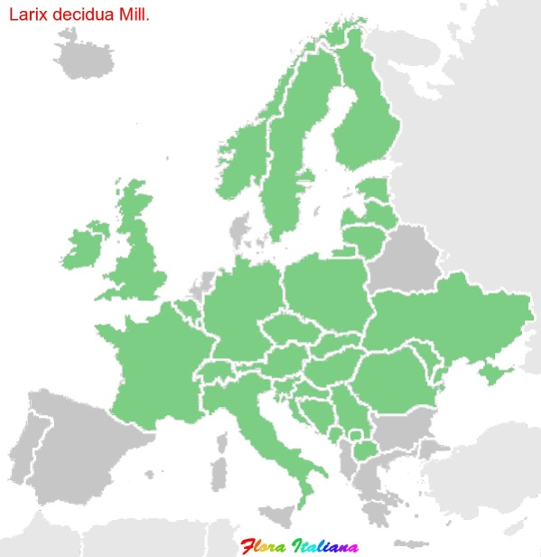
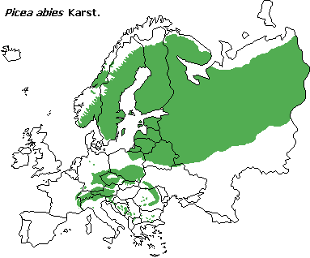
Study Species
Larix decidua
Family: Pinaceae
Picea abies
Altitudinal range
Altitudinal range
550/600m
2500m
Optimum
1200/2100m
700-800m
2200m
Optimum 1200/1800m
Distribution Area
Distribution Area
Orof. Centroeurop.
Central Europe
Central Asia
Carpathians
Europe
Alps
Eurosib.

Slide 10
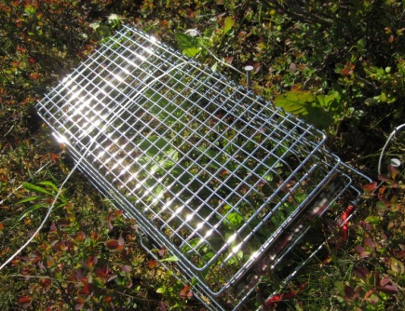
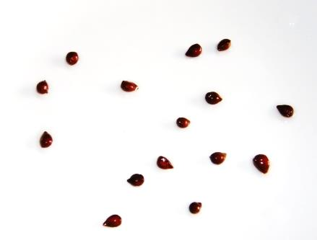
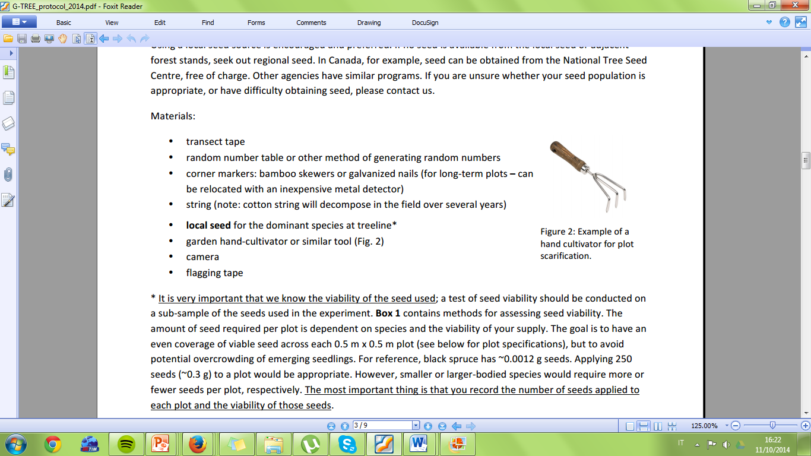
Site level treatments
For each site
20 plots: 5 replicates of each treatment combination
4 different treatment combinations:
Full control (unseeded, non-scarified)
Seeded (seeded, non-scarified)
Scarified (non-seeded, scarified)
Seeded + scarified
Randomly distributed within a site
Randomly assigned to different plots
TREATMENTS
Herbivore exclosure
Plot sowing
Plot scarification
Notes:
Sowing followed the natural seed dispersal time of study species

Slide 11
Plot level treatments
4 herbivore exclosures
PL1
PL1
LH1
LH1
PL2
PL2
PH2
45 cm
PH1
PH1
LL2
LL2
LH2
LH2
LL1
2 metres
For each plot
16 subplots:
2 species (Picea abies and Larix decidua) Pvs L
2 provenances (high vs low elevation) Hvs L
2 sowing years (2013 and 2014) 1vs 2
Herbivore exclosure (8 subplots with and 8 subplots without)
Random distribution within the plot
Notes:
8 out of 16

Slide 12
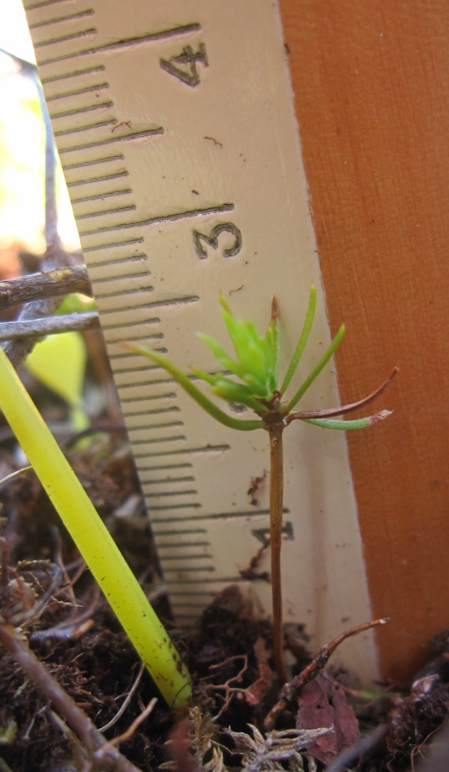
Seedling assessments
Seedling counts + measurements:
2013: 1 x October
2014: 3 x June, August, September (Ms thesis: Eva Bianchi)
2015: 2 x June, September
Measurements:
Seedling height:
- Total height
- Stem length
Climate data
Site level:
- Total height
- Stem length

Slide 13
Environmental variables
Site level measurements:
Soil temperature (2013-15)
pH (2014)
Soil moisture (2014)
Subplot surface cover (litter, mineral soil, rock, lichens, vegetation)
Climate station Stillberg (close to T-Site):
Snow depth, precipitation, wind, air temperature…

Slide 14
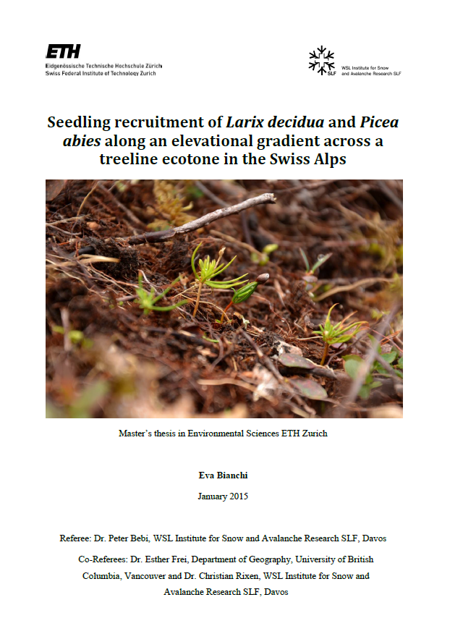
Ms Thesis Eva Bianchi

Slide 16

Results

Slide 17
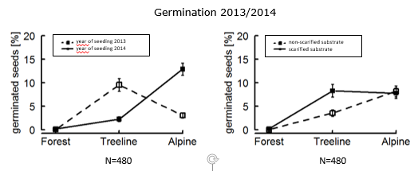
Germination

Slide 18
In all 3 years,
NO NATURAL REGENERATION
in any of the three zones
Unseeded plots
Germination (%) = 0
In both species seeded in 2013,
NO SECOND YEAR GERMINATION
in any of the three zones

Slide 19
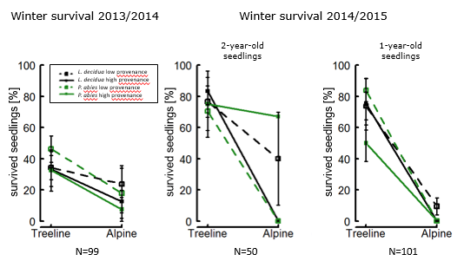
Survival

Slide 20
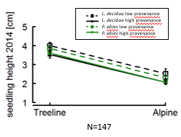
Growth

Slide 22
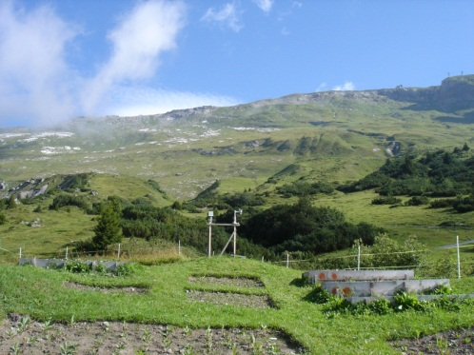
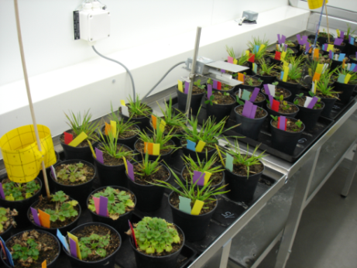



PhD project: Plant population differentiation and climate change: responses of grassland species along an elevational gradient
common garden transplant experiment
local adaptation
1800 m
phenotypic plasticity
1200 m
climate chamber experiment
population origin
Frei et al. (2014) Global Change Biology

Slide 23
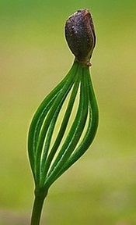
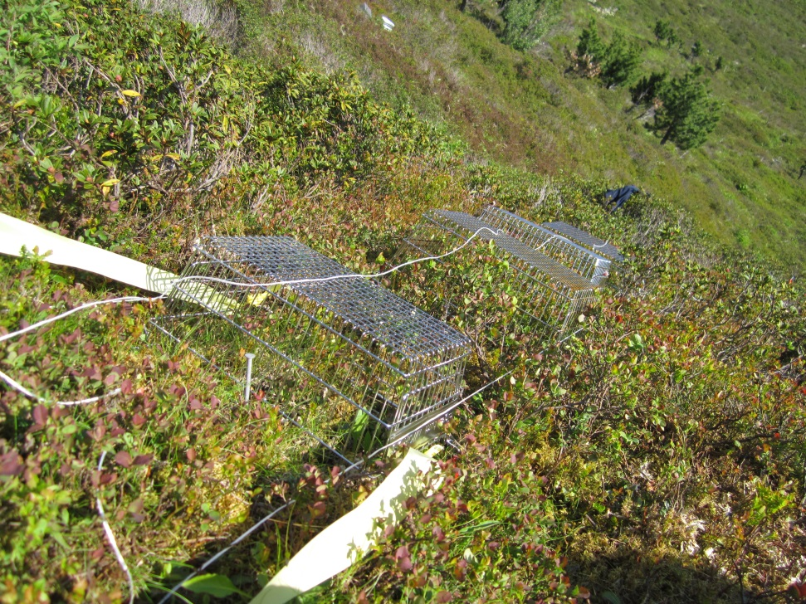

G-TREE project SLF: Global Treeline Range Expansion Experiment
→ substrate and seed limitations on range expansion

Slide 24
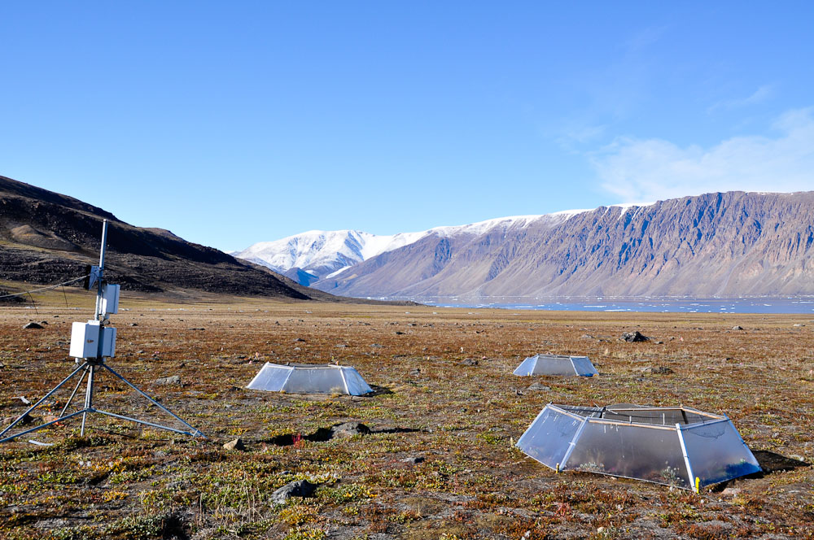
PostDoc: Climate change effects on High Arctic tundra species
Plant populations & climate change
Photo: Anne Bjorkman
Notes:
Starting this summer, I plan to broaden my knowledge on experimental Arctic ecology with a post doctoral stay in the Lab of Greg Henry at UBC Vancouver. I plan to investigate plant responses to experimental warming and snow manipulation at the High Arctic International Tundra Experiment site Alexandra Fiord on Ellesmere Island.

